Slide 1

Business & Purchasing Office
Board Presentation
July 21, 2021
SEE THE IMPACT

Slide 2

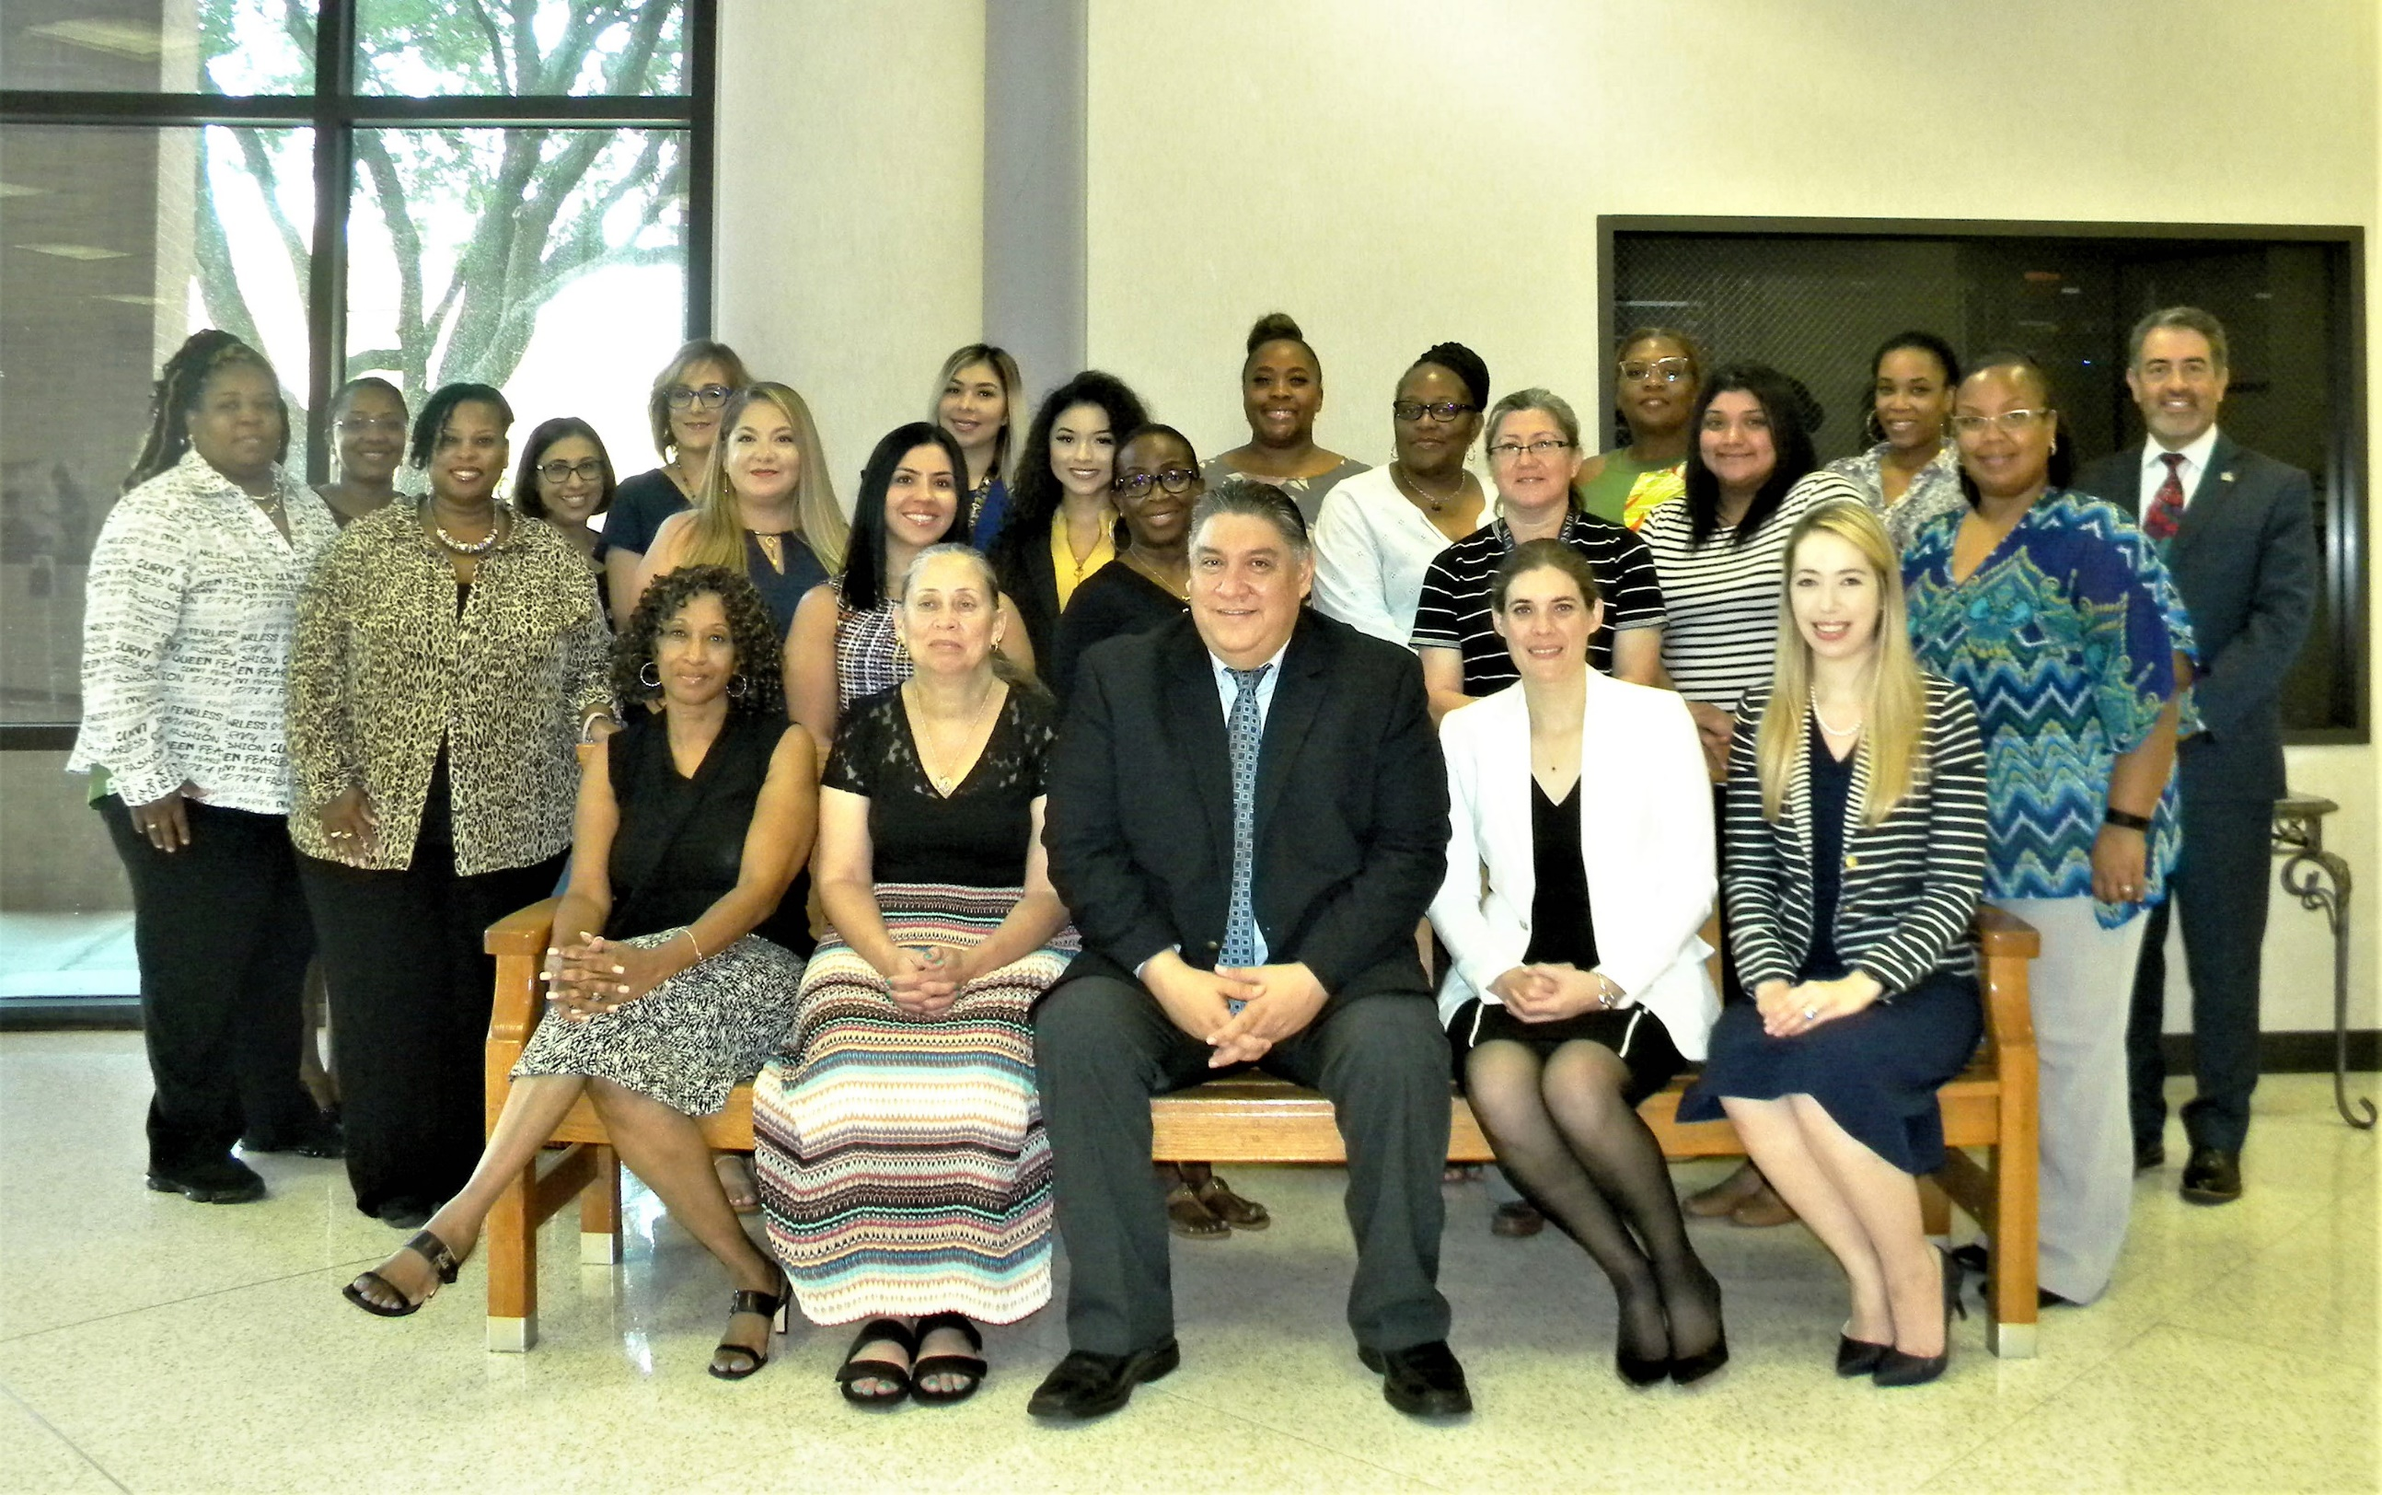
Business & Purchasing
Who We Are
About Us:
Mission & Focus:
To exceed client expectations by maximizing fiscal resources and providing quality support services
SEE THE IMPACT

Slide 3
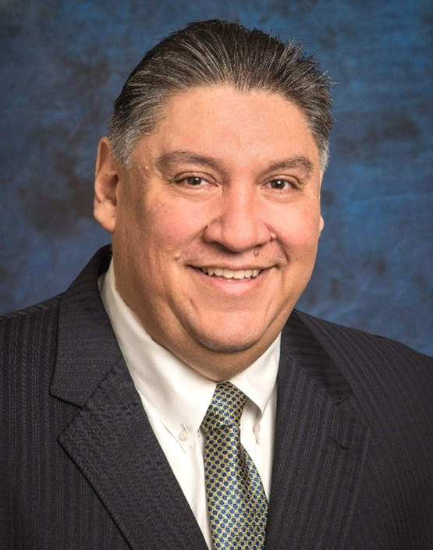
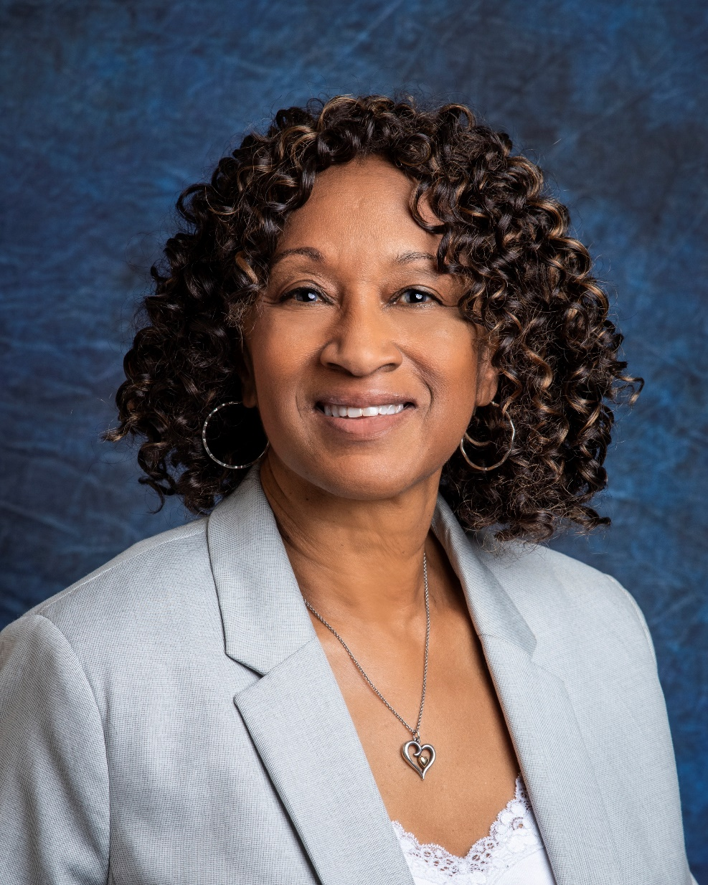
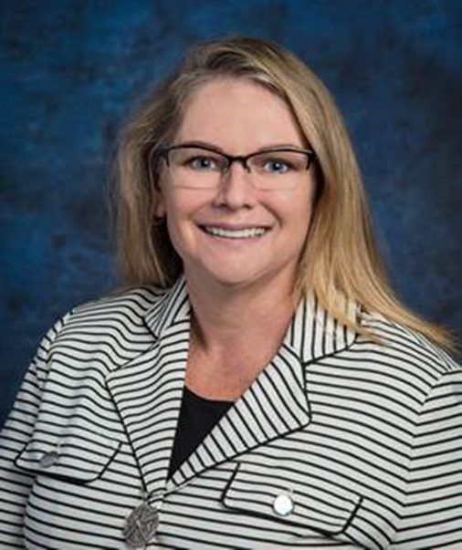
Business & Purchasing
Leadership Group
About Us:
GOAL #1
•Impact education by responding to the evolving needs of Harris County
GOAL #2
•Deliver value to Harris County by utilizing resources in an ethical, transparent and fiscally responsible manner
GOAL #3
Provide cost savings to school districts by leveraging tax dollars
over 90 years of experience
Stephanie Barnett
Chief Accounting Officer
Dr. Jesus Amezcua
Assistant Superintendent
for Business Support Services
Kendra Jackson
Purchasing Director
Vacant in 2021

Slide 4

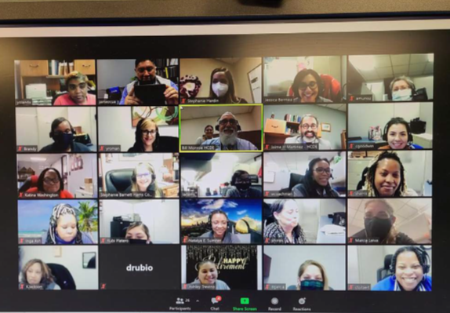
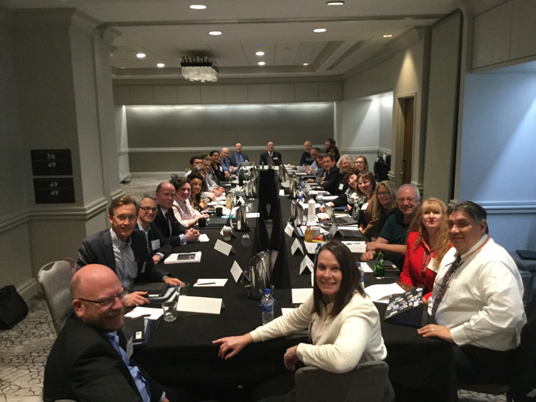
Business & Purchasing
Service
Highlights
Continued Division Support
Best Practice Committee - CPAs

Slide 5
Business & Purchasing
Fraud Awareness Award
Risk Assessment Process
EDGAR Compliant and Leader
2021 Pinnacle Award Winner
648 attendees at School Finance Council
8 National Awards
Presentations at Conferences. TASBO, ISM, etc
No Letter to Management Comments – Unmodified Opinion
Service
Highlights

Slide 6

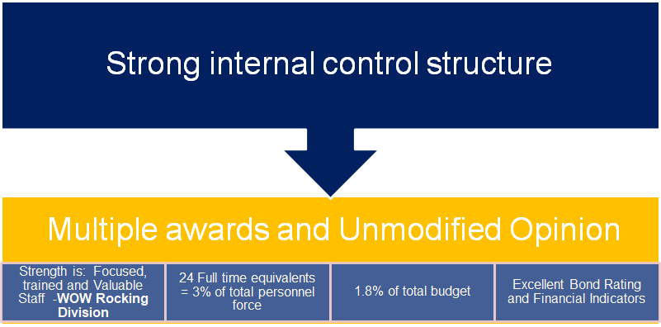
Business & Purchasing
The Bottom Line

Slide 7
Business & Purchasing
Ratios | Calculation | Benchmark | Most Current - FY 21
1.Repayment Analysis
Debt Payment/Income Ratio | Debt Payment/Income | < 25% | 6%
2.Liquidity Analysis
Current Ratio | Assets/Liabilities | > 1 | 1.34
3.Solvency Analysis
Debt/Asset Ratio | Liabilities/Assets | Between 35% and %50% | 75%
4.Profitability Analysis
Return on Assets | Income to Assets | 2% | 3%
Return on Equity | Income to Equity | 7% | 9%
Performance
Ratios

Slide 8
Business & Purchasing
5.Financial Capability Analysis
Bonded Debt per Capita | Long-term general obligation debt to taxpayers. (includes pension) | Betw $5.00 & $12.5 | 3.40
Property Taxes per Capita | Amount of tax burden to taxpayer. | Betw $5.32 & $10.66 | $ 3.40
Debt Service Load | Amount of annual budget used to pay off long-term debt. | Betw 5% to 10% | 4%
6.Financial Position Analysis
Unassigned Fund Balance | % of annual revenue | Between 15% & 30% | 22%
7.Financial Efficiency Analysis
Gross Revenue > Operating Expenditures | General Fund Results | Between $800K & $1.5M | $ 3,003,565
Performance
Ratios
2020 Population 4,767,540

Slide 9
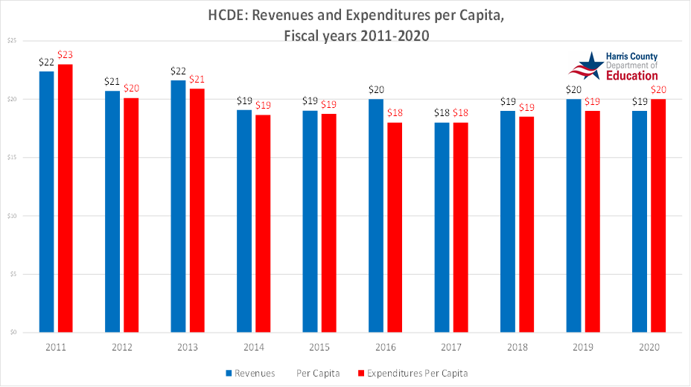
Business & Purchasing
Revenue/
Expenditure
Per
Capita
2020 Population 4,767,540

Slide 10
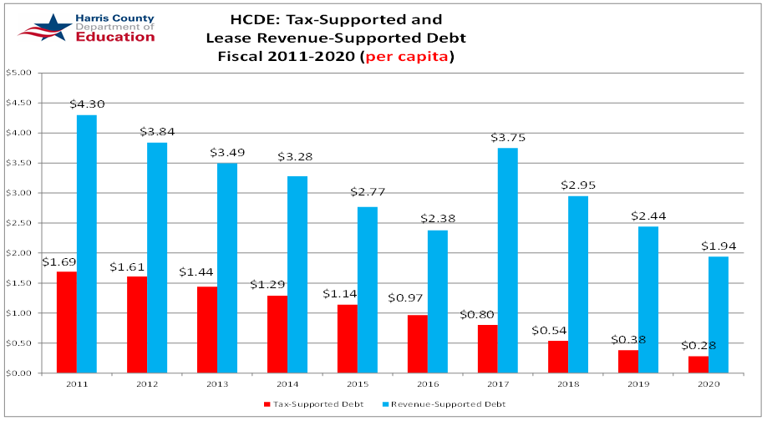
Business & Purchasing
Debt
Per
Capita
2020 Population 4,767,540

Slide 11
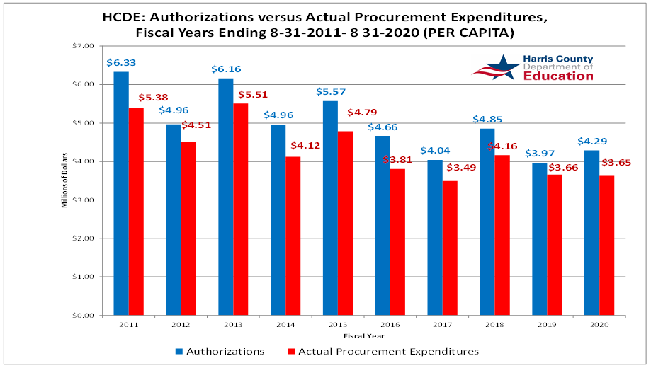
Business & Purchasing
Purchases
Per
Capita
2020 Population 4,767,540

Slide 12
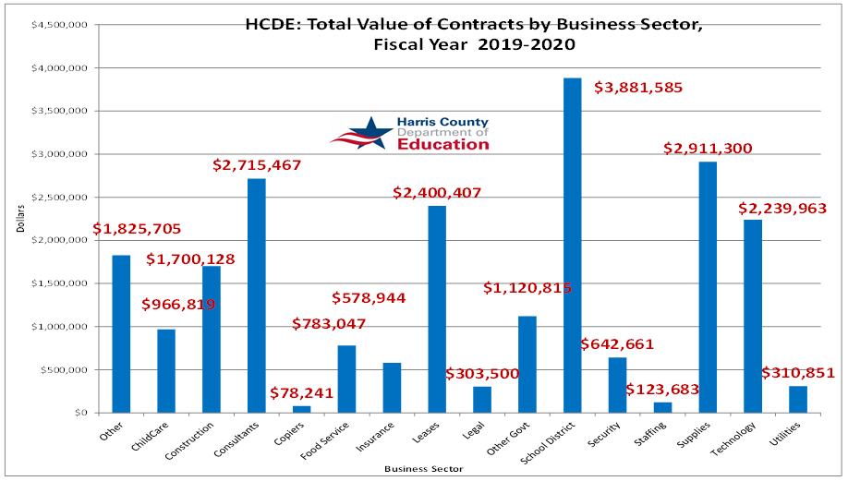
Business & Purchasing
Contracts
By
Sector

Slide 13

Business & Purchasing
Key Highlights
EDGAR Class and Webinar
• Participated as a REAL SuperMENtor where Dr. Amezcua and Jaime
Martinez read to children at a Head Start center via zoom
• Dr. Amezcua is on the Education Committee for the Rotary Club and Adoption Fair
held at HCDE
• Taught financial courses at Principal and Superintendent Academy
Taught EDGAR Courses for Institute of Supply Management
• Taught EDGAR rules to other school district staff
• Taught several financial courses to City of Houston employees
• Dr. Amezcua also participated in TASBO committees
• Best Practice Committee-Texas Certified Public Accountants
• Best Practice Committee-GFOA and ASBO
Assisted various ISDs- Pearland ISD, Stafford MSD and Beeville ISD

Slide 14

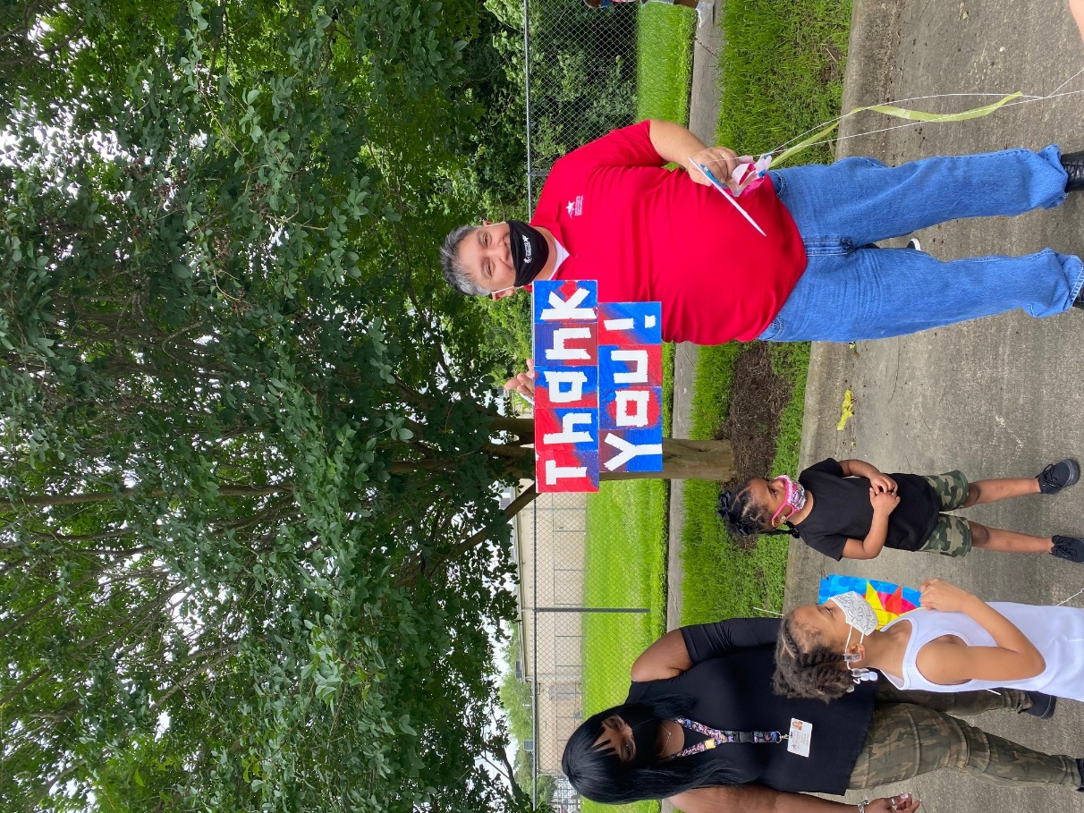
Business & Purchasing
SEE THE IMPACT
Questions?

